Slide 1
The Analysis and Design of Computer Algorithms
CIS*3490 Winter 2021

Slide 2
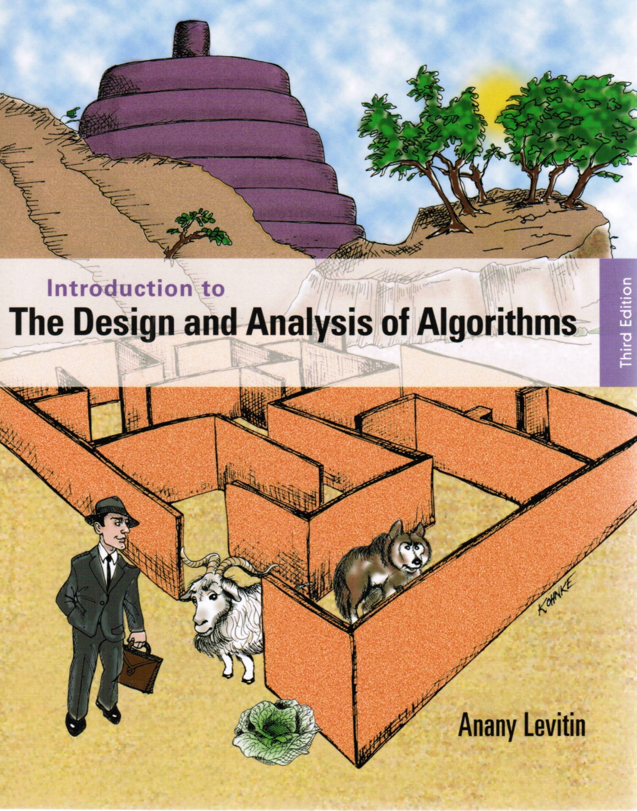
Chapter 3
Brute Force and
Exhaustive Search

Slide 3

Brute Force
A straightforward approach, usually based directly on the problem’s statement and definitions of the concepts involved
Examples:
Computing n!
Computing a^{n} (a > 0, n is a nonnegative integer)
Sequential searching for a key of a given value in a list
Multiplying two matrices

Slide 4
Brute-Force Sorting Algorithms
Selection Sort Scan the array to find its smallest element and swap it with the first element. Then, starting with the second element, scan the elements to the right of it to find the smallest among them and swap it with the second elements. Generally, on pass i (0 ≤ i ≤ n-2), find the smallest element in A[i..n-1] and swap it with A[i]: A[0] ≤ . . . ≤ A[i-1] | A[i], . . . , A[min], . . ., A[n-1]
in their final positions

Slide 5
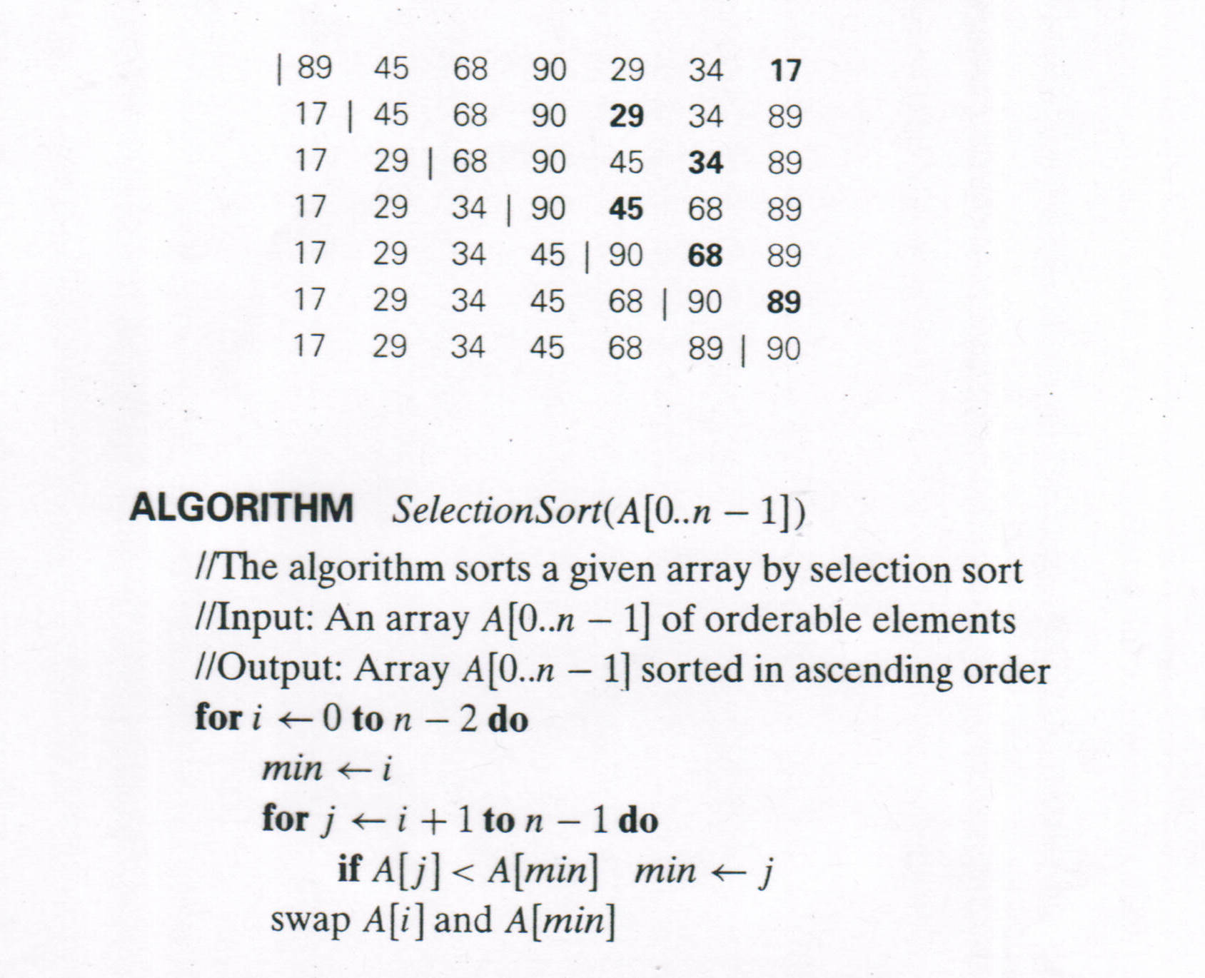
Selection Sort

Slide 6
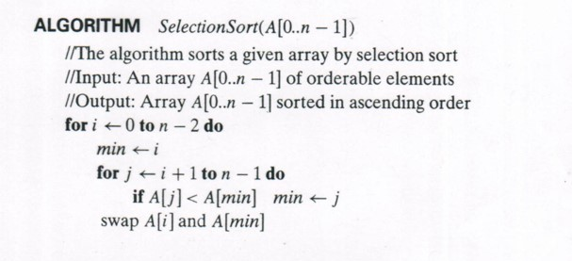

Analysis of Selection Sort
$C\left(n\right)=\sum_{i=0}^{n−2}{ }\sum_{j=i+1}^{n−1}{1}$ = $\sum_{i=0}^{n−2}{[\left(n−1\right)−\left(i+1\right)+1]}$ = $\sum_{i=0}^{n−2}{(n−1−i)}$
= $\sum_{i=0}^{n−2}{(n−1)}−$ $\sum_{i=0}^{n−2}{i}=$ $(n−1)\sum_{i=0}^{n−2}{1}−$ $\sum_{i=0}^{n−2}{i}$
$=\left(n−1\right)\left(n−1\right)+$ $\frac{\left(n−2\right)\left(n−1\right)}{2}=$ $\left(n−1\right)[\left(n−1\right)+$ $\frac{\left(n−2\right)}{2}]=\left(n−1\right)\left(\frac{n}{2}\right)$
$=\frac{n\left(n−1\right)}{2}=\frac{n^{2}}{2}−\frac{n}{2}$ $∈$ Θ($n^{2}$)

Slide 7
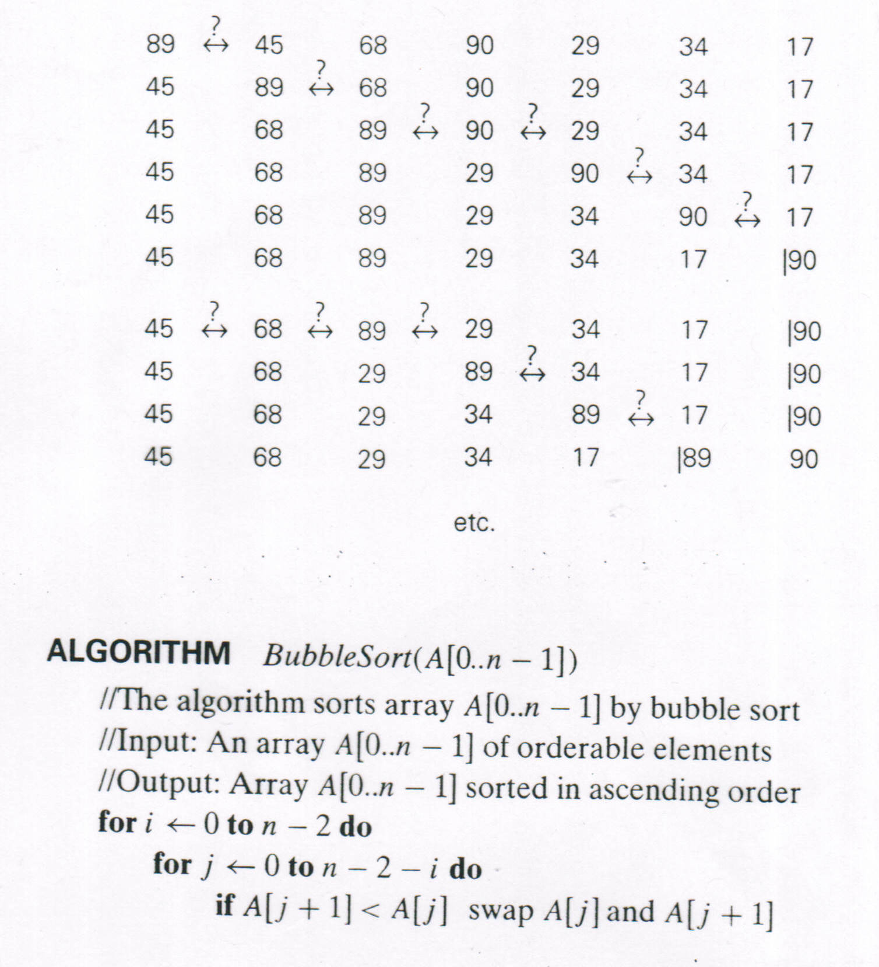
Bubble Sort
i=0
j=0
j=1
j=2,3
j=4
j=5
i=1
j=0,1,2
j=3
j=4

Slide 8
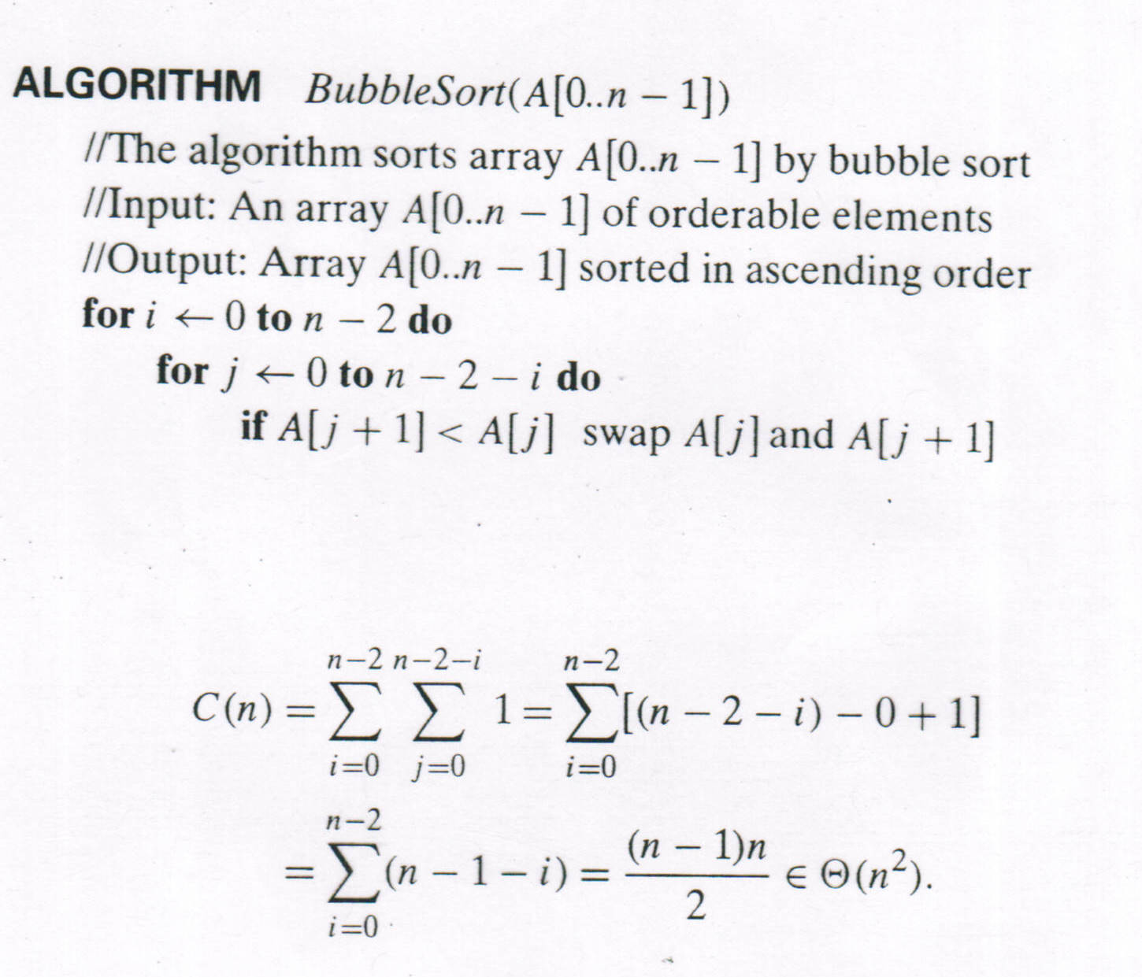
Analysis of Bubble Sort

Slide 9
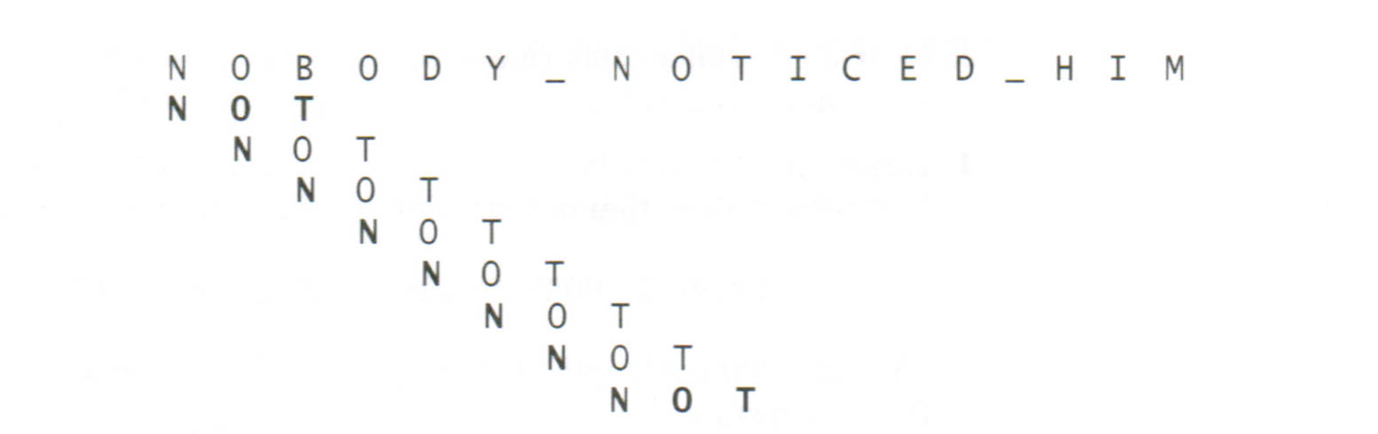
Example of Brute-Force String Matching
pattern: a string of m characters to search for
text: a (longer) string of n characters to search in
problem: find a substring in the text that matches the pattern
text
pattern

Slide 10
Example of Brute-Force String Matching
Step 1 Align pattern at beginning of text
Step 2 Moving from left to right, compare each character of pattern to the corresponding character in text until
all characters are found to match (successful search); or
a mismatch is detected
Step 3 While pattern is not found and the text is not yet exhausted, realign pattern one position to the right and repeat Step 2

Slide 11
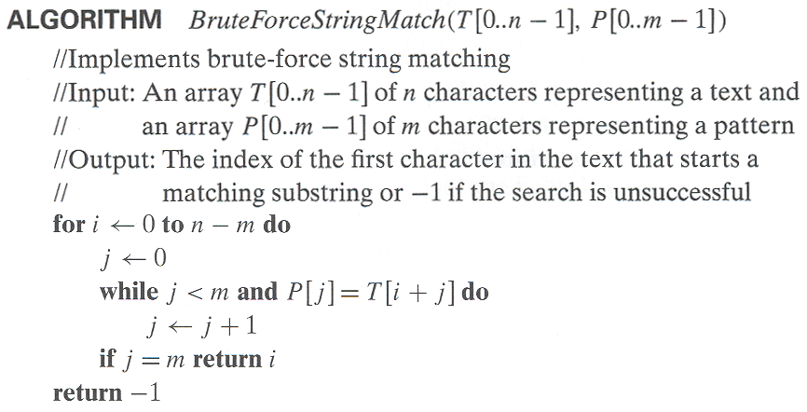
Pseudocode and Efficiency
Efficiency: ?

Slide 12

Brute-Force Polynomial Evaluation
Problem: Find the value of polynomial
p(x) = a_{n}x^{n} + a_{n-1}x^{n-1} +… + a₁x¹ + a₀
at a point x = x₀
Brute-force algorithm
Efficiency: ?
Example:
p(x) = 5x² + 4x + 11
x = 3
p = 0
i = 2
power = 1 $∗$3 $∗$3 = 9, p = 0 + 5 $∗$ 9 = 45
i = 1
power = 1 $∗$3, p = 45 + 4 $∗$ 3 = 57
i = 0
power = 1, p = 57 + 11 $∗$ 1 = 68
p ← 0.0
for i ← n downto 0 do
power ← 1
for j ← 1 to i do //compute x^{i}
power ← power ∗ x
p ← p + a[i] ∗ power
return p

Slide 13
Brute-Force Polynomial Evaluation
Problem: Find the value of polynomial
p(x) = a_{n}x^{n} + a_{n-1}x^{n-1} +… + a₁x¹ + a₀
at a point x = x₀
Brute-force algorithm
Efficiency: ?
Example:
p(x) = 5x² + 4x + 11
x = 3
p = 0
i = 2
power = 1 $∗$3 $∗$3 = 9, p = 0 + 5 $∗$ 9 = 45
i = 1
power = 1 $∗$3, p = 45 + 4 $∗$ 3 = 57
i = 0
power = 1, p = 57 + 11 $∗$ 1 = 68
p ← 0.0
for i ← n downto 0 do
power ← 1
for j ← 1 to i do //compute x^{i}
power ← power ∗ x
p ← p + a[i] ∗ power
return p

Slide 14

Polynomial Evaluation: Improvement
We can do better by evaluating from right to left:
p(x) = a_{n}x^{n} + a_{n-1}x^{n-1} +… + a₁x¹ + a₀
Better brute-force algorithm
Efficiency: ?
Example:
p(x) = 5x² + 4x + 11
x = 3
p = 11, power = 1
i = 1
power = 1 $∗$ 3 = 3, p = 11 + 4 $∗$ 3 = 23
i = 2
power = 3 $∗$ 3 = 9, p = 23 + 5 $∗$ 9 = 68
p ← a[0]
power ← 1
for i ← 1 to n do
power ← power ∗ x
p ← p + a[i] ∗ power
return p

Slide 15
Closest-Pair Problem
Find the two closest points in a set of n points (in the two-dimensional Cartesian plane).
Brute-force algorithm
Compute the distance between every pair of distinct points, and return the indexes of the points for which the distance is the smallest.
Example:
Calculate d(p1,p2), d(p1,p3), d(p1,p4), d(p2,p3), d(p2,p4), d(p3,p4) to find the smallest.
p1
p2
p4
p3
Notes:
Draw example.

Slide 16
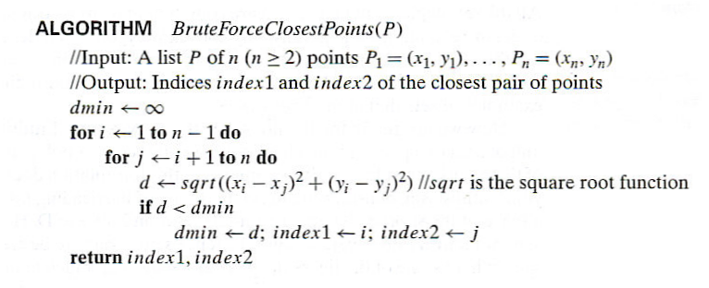
Closest-Pair Brute-Force Algorithm (cont.)
Efficiency: ?
Notes:
The basic operation of the algorithm is computing the Euclidean distance between two points.
The square root is a complex operation who’s result is often irrational, therefore the results
can be found only approximately. Computing such operations are not trivial. One can avoid
computing square roots by comparing distance squares instead.

Slide 17
Brute-Force Strengths and Weaknesses
Strengths
wide applicability
simplicity
yields reasonable algorithms for some important problems (e.g., matrix multiplication, sorting, searching, string matching)
Weaknesses
rarely yields efficient algorithms
some brute-force algorithms are unacceptably slow
not as constructive as some other design techniques

Slide 18
Exhaustive Search
A brute force approach to a problem involving search for a solution with a special property, usually among combinatorial objects such as permutations, combinations, or subsets of a set.
Method:
generate a list of all potential solutions to the problem in a systematic manner
evaluate potential solutions one by one, disqualifying infeasible ones and, for an optimization problem, keeping track of the best one found so far
when search ends, announce the solution(s) found

Slide 19
Example 1: Traveling Salesman Problem (TSP)
Given n cities with known distances between each pair, find the shortest tour that passes through all the cities exactly once before returning to the starting city
Alternatively: Find shortest Hamiltonian circuit in a weighted connected graph
Example:
2
a
b
5
3
8
4
c
d
7

Slide 20

TSP by Exhaustive Search
Tour Cost
a→b→c→d→a 2+3+7+5 = 17
a→b→d→c→a 2+4+7+8 = 21
a→c→b→d→a 8+3+4+5 = 20
a→c→d→b→a 8+7+4+2 = 21
a→d→b→c→a 5+4+3+8 = 20
a→d→c→b→a 5+7+3+2 = 17
Number of tours: (n $−$1)! Efficiency: n!
2
a
b
5
3
8
4
c
d
7

Slide 21
Example 2: Knapsack Problem
Given n items and a knapsack:
weights: w₁ w₂ … w_{n}
values: v₁ v₂ … v_{n}
a knapsack of capacity W
Find the most valuable subset of the items that fit into the knapsack
Example: Knapsack capacity W=16
item weight value
2 $20
5 $30
10 $50
5 $10

Slide 22

Knapsack Problem by Exhaustive Search
4321 Subset Total weight Total value
0001 {1} 2 $20
0010 {2} 5 $30
0100 {3} 10 $50
1000 {4} 5 $10
0011 {1,2} 7 $50
0101 {1,3} 12 $70
1001 {1,4} 7 $30
0110 {2,3} 15 $80
1010 {2,4} 10 $40
1100 {3,4} 15 $60
0111 {1,2,3} 17 not feasible
1011 {1,2,4} 12 $60
1101 {1,3,4} 17 not feasible
1110 {2,3,4} 20 not feasible
1111 {1,2,3,4} 22 not feasible
Example: Knapsack capacity W=16
item weight value
2 $20
5 $30
10 $50
5 $10
Number of subsets: $2^{n}$
Efficiency: Θ($2^{n}$)

Slide 23
Knapsack Problem by Exhaustive Search
4321 Subset Total weight Total value
0001 {1} 2 $20
0010 {2} 5 $30
0100 {3} 10 $50
1000 {4} 5 $10
0011 {1,2} 7 $50
0101 {1,3} 12 $70
1001 {1,4} 7 $30
0110 {2,3} 15 $80
1010 {2,4} 10 $40
1100 {3,4} 15 $60
0111 {1,2,3} 17 not feasible
1011 {1,2,4} 12 $60
1101 {1,3,4} 17 not feasible
1110 {2,3,4} 20 not feasible
1111 {1,2,3,4} 22 not feasible
Example: Knapsack capacity W=16
item weight value
2 $20
5 $30
10 $50
5 $10
Number of subsets: $2^{n}$
Efficiency: Θ($2^{n}$)

Slide 24
Example 3: The Assignment Problem
There are n people who need to be assigned to n jobs, one person per job. The cost of assigning person i to job j is C[i,j]. Find an assignment that minimizes the total cost.
Job 1 Job 2 Job 3 Job 4
Person 1 9 2 7 8
Person 2 6 4 3 7
Person 3 5 8 1 8
Person 4 7 6 9 4
Algorithmic Plan: Generate all legitimate assignments, compute their costs, and select the cheapest one.
How many assignments are there? n! Efficiency: Θ(n!)

Slide 25
Assignment Problem by Exhaustive Search
Algorithmic Plan: Generate all legitimate assignments, compute their costs, and select the cheapest one.
How many assignments are there? n!
Efficiency: Θ(n!)
9 2 7 8
6 4 3 7
5 8 1 8
7 6 9 4
Assignment (col.#s) Total Cost
1, 2, 3, 4 9+4+1+4=18
1, 2, 4, 3 9+4+8+9=30
1, 3, 2, 4 9+3+8+4=24
1, 3, 4, 2 9+3+8+6=26
1, 4, 2, 3 9+7+8+9=33
1, 4, 3, 2 9+7+1+6=23
etc.
C =

Slide 26
Final Comments on Exhaustive Search
Exhaustive-search algorithms run in a realistic amount of time only on very small instances
In many cases, exhaustive search or its variation is the only known way to get exact solution

Slide 27
Graph Traversal
Many problems require processing all graph vertices (and edges) in systematic fashion
Graph traversal algorithms:
Depth-first search (DFS)
Breadth-first search (BFS)

Slide 28
Depth-First Search (DFS)
Visits graph’s vertices by always moving away from last visited vertex to unvisited one, backtracks if no adjacent unvisited vertex is available.
Uses a stack
a step starts with the vertex at the top of the stack
a vertex is pushed onto the stack when it’s reached for the first time
a vertex is popped off the stack when it becomes a dead end, i.e., when there is no adjacent unvisited vertex

Slide 29
DFS Example 1
2
A
unexplored vertex
A
A
A
visited vertex
B
D
E
unexplored edge
B
D
E
discovery edge
B
C
C
back edge
A
3
1
A
A
A
A
A
A
A
B
D
B
D
E
B
D
E
B
D
E
C
B
D
E
B
D
E
E
B
C
C
C
C
C
C
A
A

Slide 30
DFS Example 1 (cont.)
5
A
unexplored vertex
A
A
A
visited vertex
unexplored edge
C
B
D
E
B
D
E
discovery edge
B
C
back edge
C
A
4
6
A
A
D
A
E
A
C
C
B
D
E
B
D
E
B
D
E
B
D
E
B
B
C
C
C
A
A
C

Slide 31
DFS Example 1 (cont.)
7
9
A
A
A
A
C
B
D
B
D
E
B
D
E
B
D
E
E
B
C
C
C
C
A
A
8
10
A
A
A
A
B
D
E
B
D
E
B
D
E
B
D
E
B
C
C
C
A
C

Slide 32
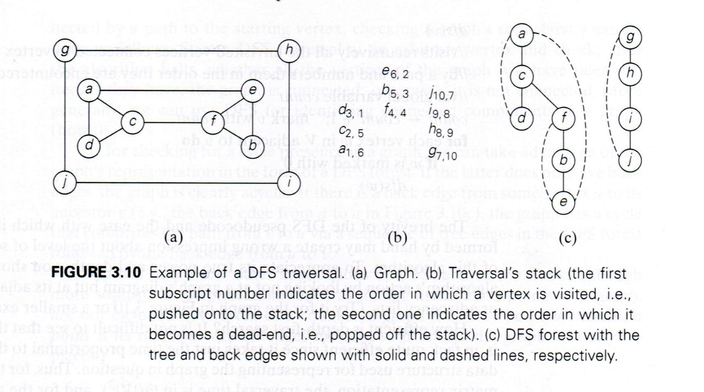
DFS Example 2

Slide 33
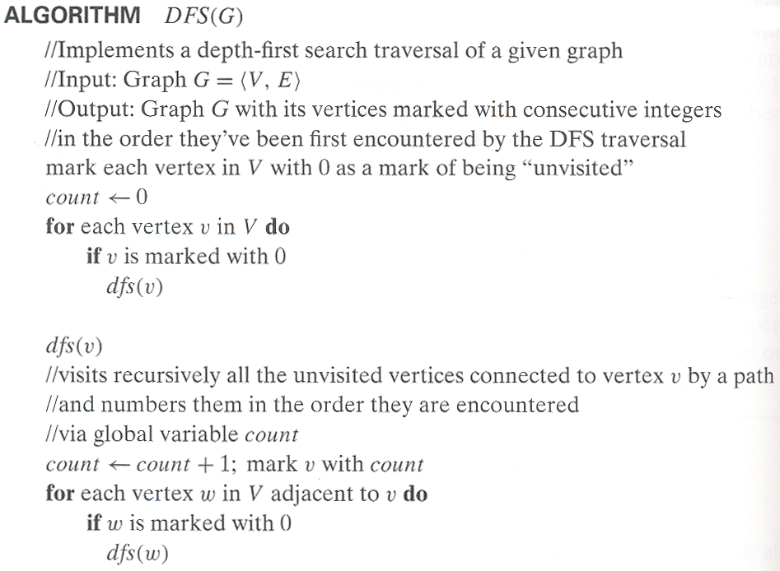
Pseudocode of DFS

Slide 34
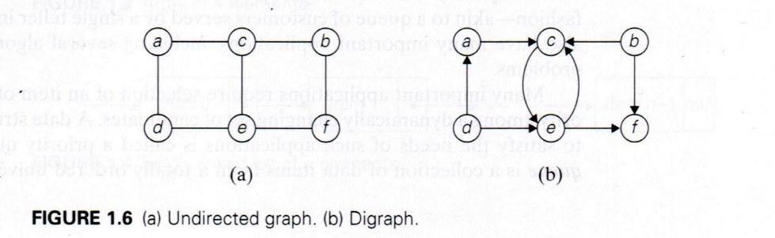
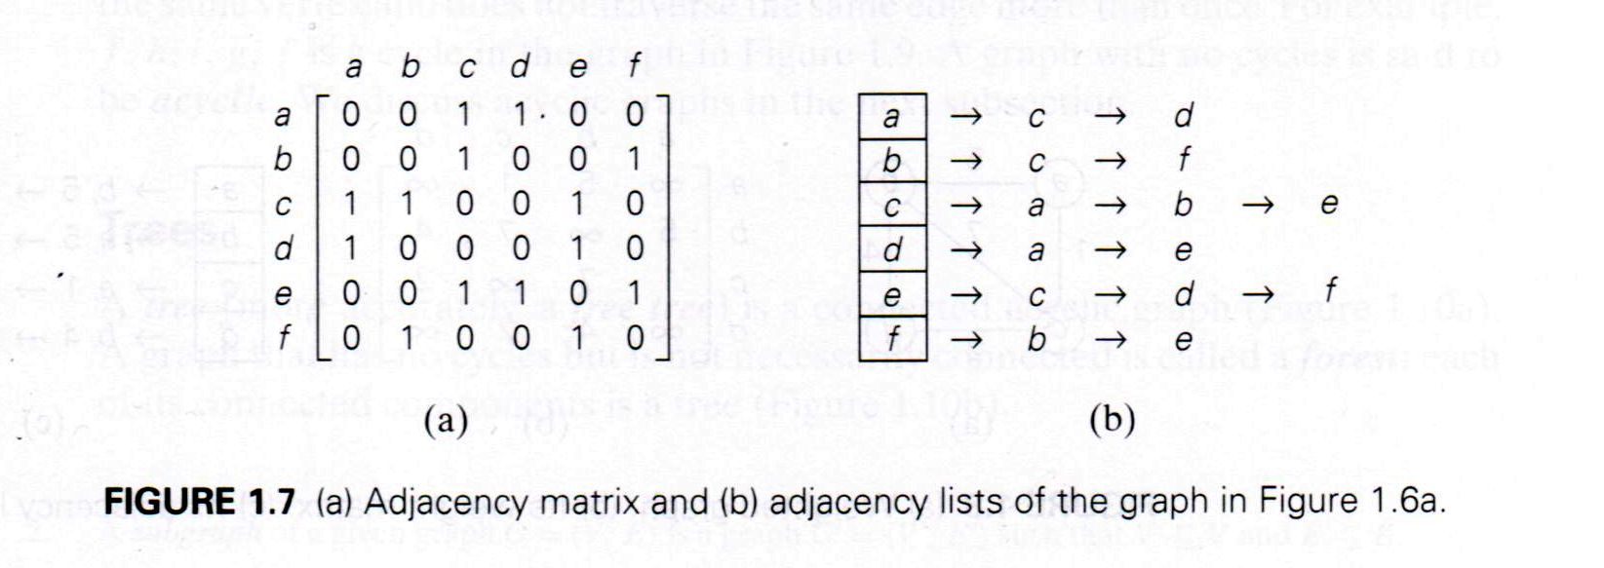
Graphs and Representations

Slide 35
Notes on DFS
DFS can be implemented with graphs represented as:
adjacency matrices: Θ(|V|²)
adjacency lists: Θ(|V|+|E|)
where | | is the operator of magnitude.
Yields two distinct ordering of vertices:
order in which vertices are first encountered (pushed onto stack)
order in which vertices become dead-ends (popped off stack)
Applications:
checking connectivity, finding connected components
checking acyclicity
searching state-space of problems for solution (AI)

Slide 36
Breadth-first search (BFS)
Visits graph vertices by moving across to all the neighbors of last visited vertex
Instead of a stack, BFS uses a queue
Similar to level-by-level tree traversal
“Redraws” graph in tree-like fashion (with tree edges and cross edges for undirected graph)

Slide 37
BFS Example 1
2
A
A
B
unexplored vertex
B
C
D
A
A
visited vertex
E
G
E
F
unexplored edge
B
C
discovery edge
B
C
D
D
H
back edge
3
A
A
A
1
A
B
C
D
B
C
D
B
G
E
F
E
F
G
E
F
G
E
C
C
D
D
E
A
E
H
H

Slide 38
Example
5
A
A
B
A
unexplored vertex
B
C
D
A
visited vertex
E
unexplored edge
E
F
G
F
G
discovery edge
E
F
G
E
H
H
back edge
6
A
A
4
A
A
B
C
D
B
B
C
D
B
E
E
F
G
E
E
F
G
F
G
H
F
G
F
G
H
D
E
F
G
D
E
H
H

Slide 39
Example
8
A
A
B
A
unexplored vertex
B
C
D
A
visited vertex
E
unexplored edge
E
F
G
discovery edge
H
H
back edge
9
7
A
A
A
A
B
C
D
B
C
D
B
B
E
E
E
F
G
E
F
G
G
H
G
H
H

Slide 40
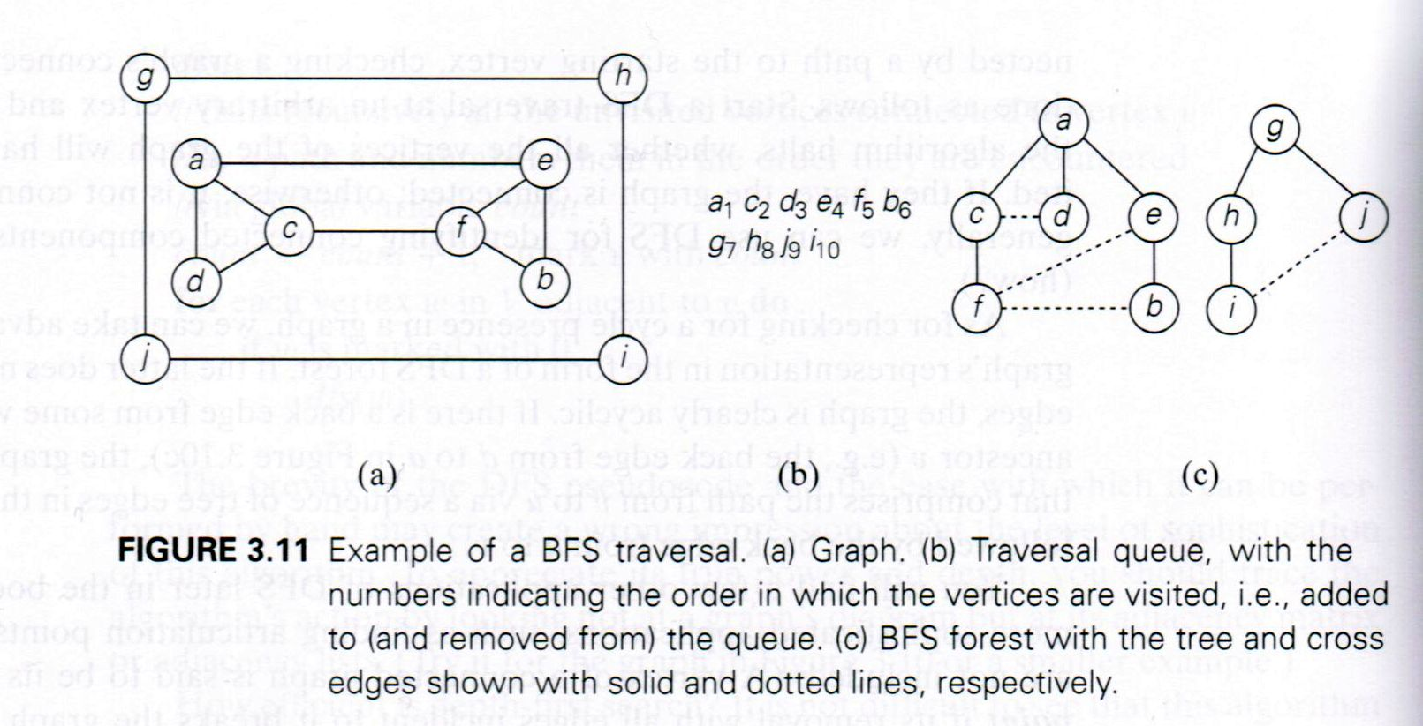
BFS Example

Slide 41
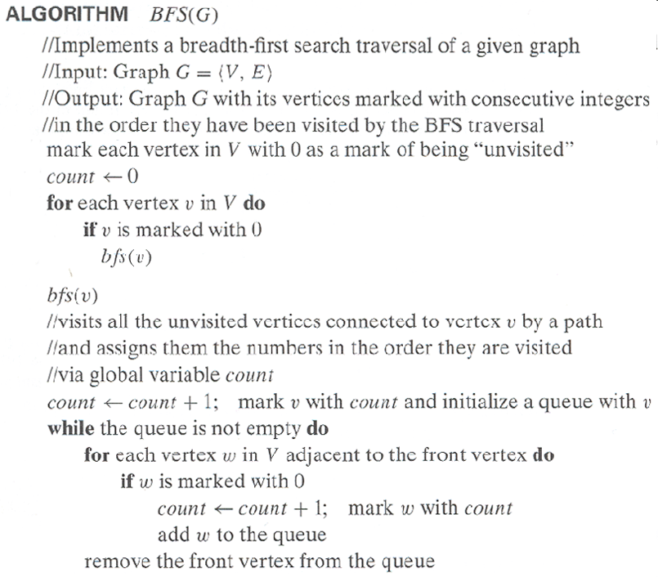
Pseudocode of BFS

Slide 42
Notes on BFS
BFS has same efficiency as DFS and can be implemented with graphs represented as:
adjacency matrices: Θ(|V|²)
adjacency lists: Θ(|V|+|E|)
Yields single ordering of vertices (order added/deleted from queue is the same)
Applications: same as DFS, but can also find paths from a vertex to all other vertices with the smallest number of edges

Slide 43
Design techniques and problem types
 | Search | Sorting | Tree | Graph | Other
Brute force, exhaustive search | Sequential search, Sequential string match | Selection sort, Bubble sort |  | Traveling salesman problem, DFS, BFS | Knapsack problem, Assignment problem
Decrease and conquer | Binary search | Insertion sort | Binary search tree | Topological sorting | Exponentiation by squaring
Divide and conquer |  | Mergysort, Quicksort | Binary tree traversal |  | Matrix multiplication, Large integer multiplication
Transform and conquer | Presorting | Heapsort | AVL tree, 2-3 tree |  | Gaussian elimination, Polynomial evaluation
Space and time tradeoff | Hashing, B-tree, Horspool algorithm | Sorting by counting
Dynamic programming |  |  | Optimal binary search trees | Warshall’s algorithm, Shortest paths problem | Knapsack problem, Memory functions
Greedy techniques |  |  |  | Minimum spanning tree | Huffman trees
Iterative improvement |  |  |  | Maximum flow Bipartite graphs | Stable marriage problem
Backtracking Branch & bound |  |  |  | Traveling salesman problem, | N-queens, Assignment, Knapsack

Slide 44
Recommended Reading
3.1
3.2
3.3
3.4
3.5

